Slide 1
MEDICAL EMERGENCY HANDLING
PIP2001 Capstone Project
Review-Final Review
Batch Number: CST-G21
Roll Number | Student Name
20211CST0058 20211CST0101 20211CST0028 20211CST0027 | MOHAMMED DANISH MANNA MUNGARA RAHUL KONDAPALLI MINITH REDDY K CHAITANYA
Under the Supervision of,
Dr. HARISH KUMAR
ASSISTANT PROFESSOR
School of Computer Science and Engineering
Presidency University
Name of the Program: B-TECH CST
Name of the HoD:
Name of the Program Project Coordinator:
Name of the School Project Coordinators: Dr. Sampath A K / Dr. Abdul Khadar A / Mr. Md Ziaur Rahman

Slide 2
Content
Problem Statement
Analysis of Problem Statement
Timeline of the Project
References

Slide 3
Problem Statement Number:
Organization: Medical Emergency Handling
Category (Hardware / Software / Both) : Software
Problem Description: Medical emergencies in India often result in delays in treatment due to inefficient coordination between ambulances, hospitals, and other entities such as blood banks. The goal of this project is to develop a mobile application that automates and parallelizes the critical events during a medical emergency, inspired by how cab booking apps like Ola and Uber handle real-time requests. The system will allow users to quickly summon ambulances, notify hospitals, register blood banks, and manage large-scale medical emergencies in real-time, ensuring rapid and coordinated care.
Difficulty Level: Complex

Slide 4
Analysis of Problem Statement
TECHNOLOGY STACK COMPONENTS:
Frontend:
HTML, CSS and Javascript for User Interaction
Brevo: Sends push notifications to users and stakeholders.

Slide 5
Analysis of Problem Statement (contd...)
Backend:
Node.js + Express.js: For creating REST APIs to handle requests like booking ambulances, registering hospitals, and managing blood banks.
Json files: For storing hospital details, blood bank registries, and emergency case records.
Brevo: Facilitates real-time updates and communication
Socket.IO: Enables two way communication for real-time ambulance tracking and updates

Slide 6
Timeline of the Project (Gantt Chart)
Phase 1: Planning & Design
Finalize requirements (ambulance booking, hospital/blood bank registration).
Phase 2: Frontend Development
Setup local environment.
Build registration, ambulance booking.
Phase 3: Backend Development
Setup Node.js backend, create APIs (ambulance, hospital, blood banks).
Store data in Json Files.
Phase 4: Notification System
Setup Brevo for real-time notifications (blood donors, hospitals, drivers).
Phase 5: Integration
Connect frontend to backend, real-time updates (tracking, availability).
Phase 6: Testing
Unit and end-to-end tests, performance under high loads.
Phase 7: Deployment
Deploy services (Brevo, Postman), publish app.

Slide 7
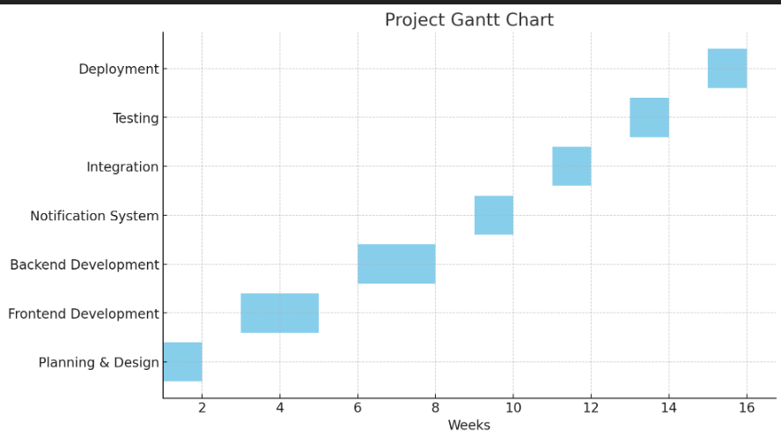
Timeline of the Project (Gantt Chart)

Slide 8

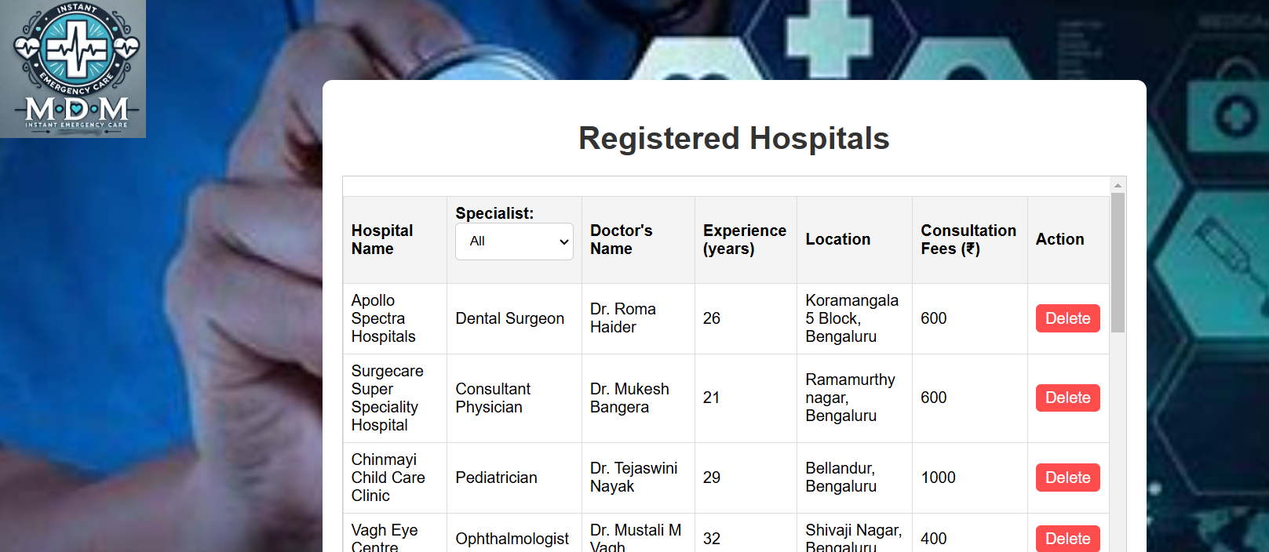
OUTPUT:

Slide 9
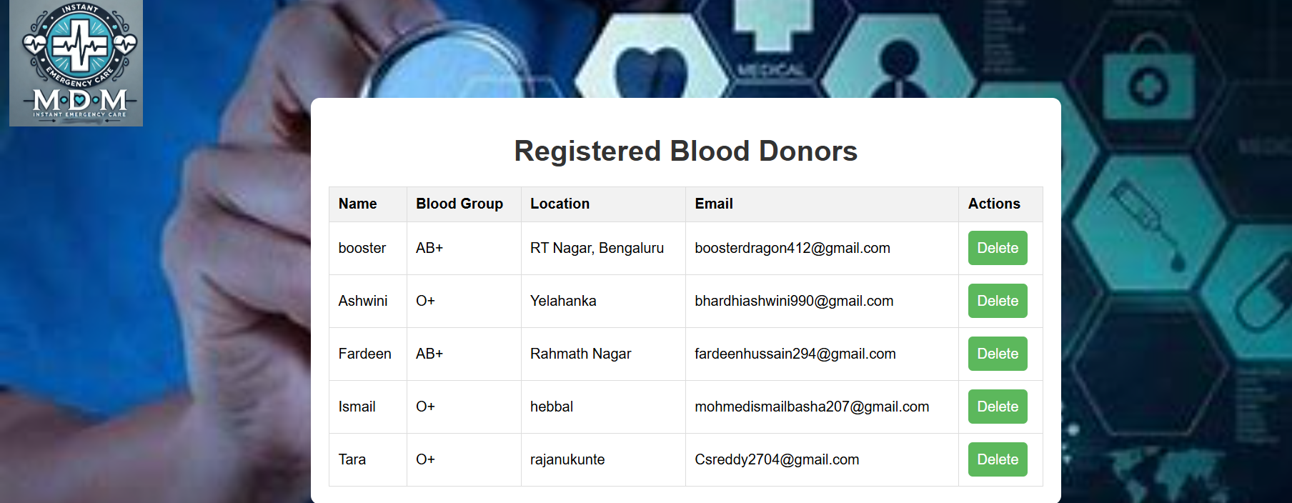
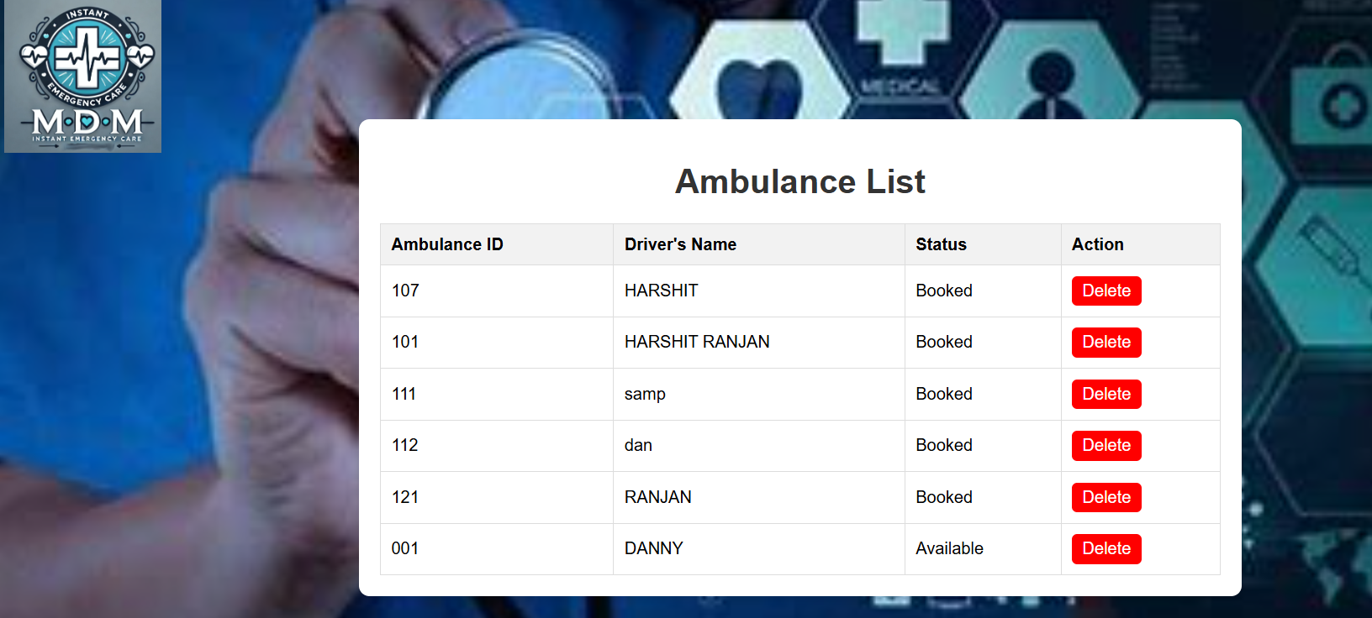
OUTPUT:

Slide 10
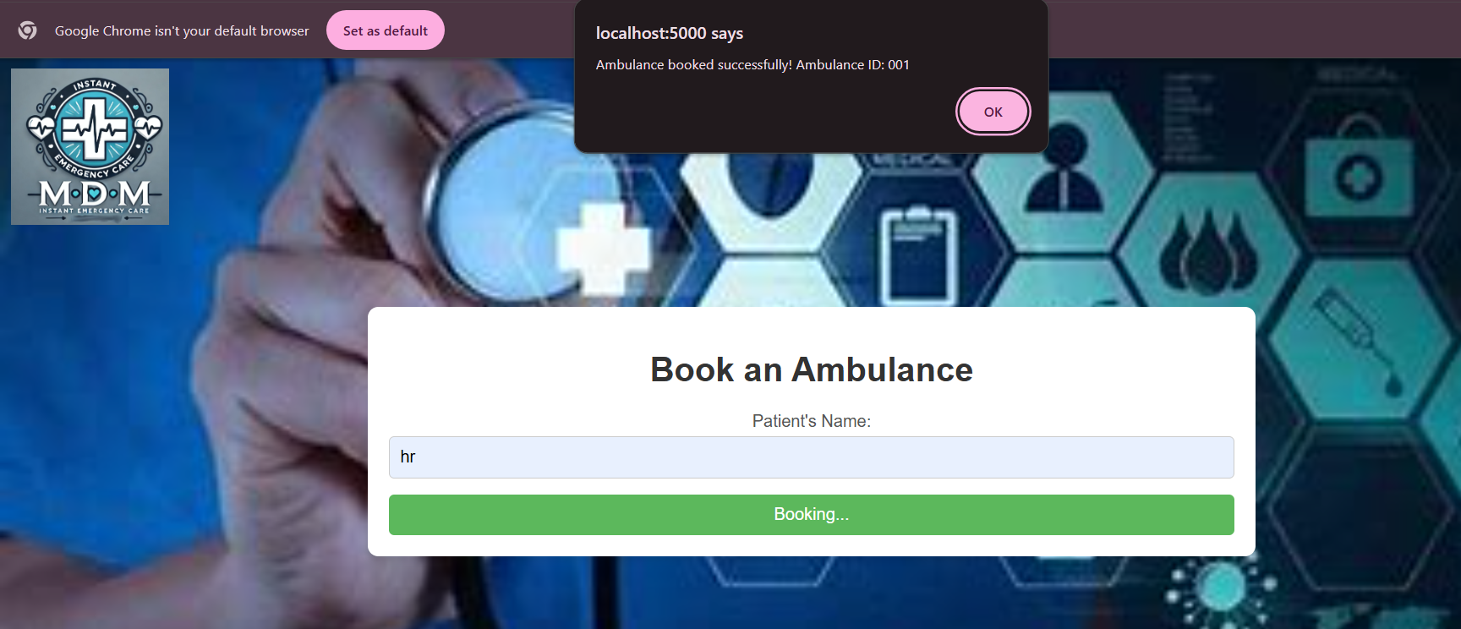
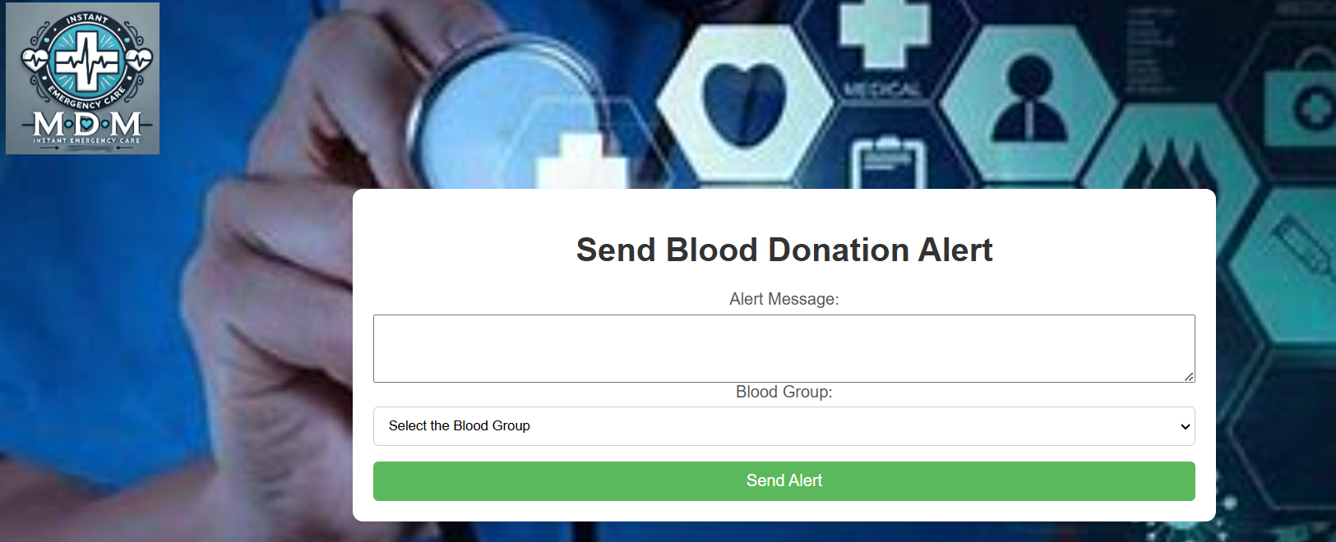
OUTPUT:

Slide 11


